Slide 1


CAPSTONE PROJECT
Air Quality Index (AQI) Monitoring Dashboard using Power BI
Presented By
Student Name: SMITA T. MHATUGADE
College Name: GOVERNMENT COLLEGE OF ENGGINEERING RATNAGIRI
Department: Artificial Intelligence and Data Science
Email ID:tanumhatugade07@gmail.com

Slide 2
OUTLINE:
Problem Statement
Proposed System/Solution
System Development Approach
Algorithm & Deployment
Result (Output Image)
Conclusion
Future Scope
References

Slide 3
Problem Statement:
Rapid urbanization and industrial growth have led to significant fluctuations in air quality across different regions.
It is difficult for public health officials and the general public to access real-time, easy-to-understand visual summaries of pollution levels.
Monitoring data is often fragmented, making it hard to identify the most polluted cities or track seasonal trends
.
There is a critical need for a centralized system to visualize pollutant concentrations and station efficiency for better environmental planning..

Slide 4
Proposed Solution:
Objective: Develop a Power BI-based analytical dashboard to provide a high-level executive overview and deep-dive pollutant analysis.
Data Collection: Gather historical and real-time air quality data including AQI values and specific pollutant levels (PM2.5, PM10, etc.) from monitoring stations.
Data Preprocessing: Clean datasets to handle missing monitoring station reports and normalize AQI classifications across states.
Dashboard Features:
Executive Overview: Tracking National Average AQI, Most Polluted State, and Total Stations.
Deep-Dive Analysis: Visualizing top 10 polluted cities and pollutant breakdowns using scatter plots and trend charts.

Slide 5
System Approach:
System Requirements: Windows 10/11, Power BI Desktop.
Technology Stack: Power BI for visualization, Power Query for ETL (Extract, Transform, Load) processes.
Data Connectivity: Integration with CSV/Excel datasets or real-time API feeds for live air quality tracking.

Slide 6
Algorithm & Deployment:
Visualization Logic: Uses DAX (Data Analysis Expressions) to calculate running averages for AQI and identify peak pollution periods.
Data Input: Historical AQI values, city-level pollutant concentrations, and monitoring station coordinates.
Training/Processing: Data is filtered through slicers for State, Year, and Air Quality Status to provide customized views.
Deployment: The dashboard is published to the Power BI Service for cloud-based accessibility and mobile viewing.

Slide 7
Result:
National Air Quality Executive Overview: Features a map visual for geographic distribution and KPI cards for quick status checks.
Pollutant & Area Deep-Dive: Includes a station efficiency scatter plot and a "Top 10 Most Polluted Cities" comparison.
Outcome: Provides actionable insights into which regions require immediate environmental intervention.

Slide 8
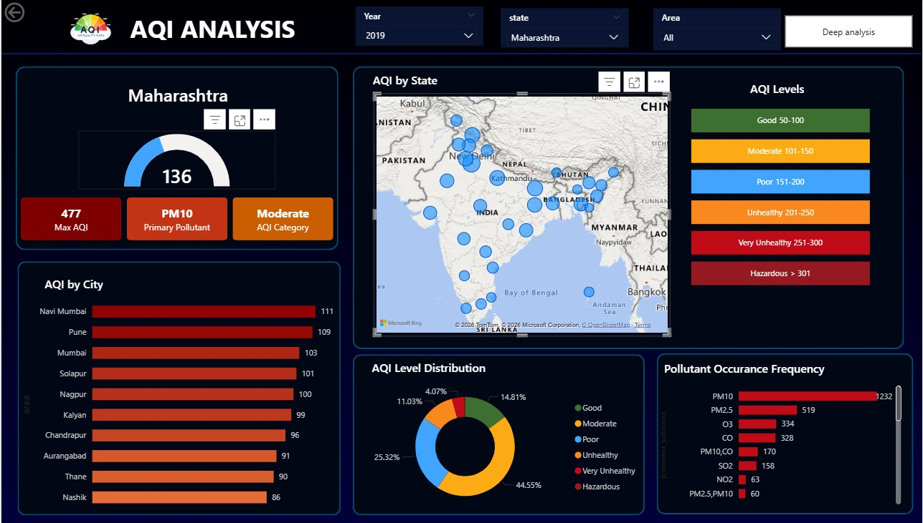

Slide 9
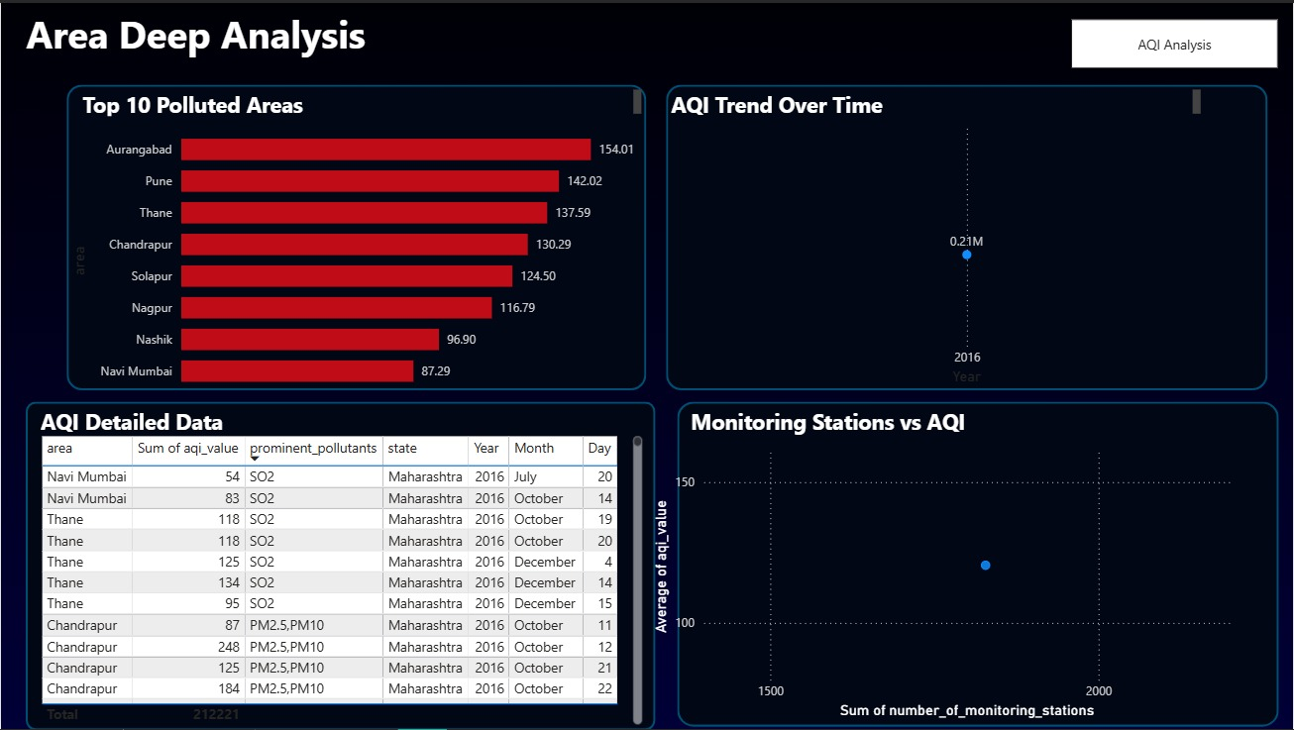

Slide 10
Conclusion:
The dashboard successfully simplifies complex environmental data into an intuitive visual format for faster decision-making.

Slide 11
Future scope:
Integration of predictive Machine Learning models (e.g., ARIMA) to forecast next-day AQI levels.
Expanding data sources to include health-related metrics like hospital admission rates for respiratory issues.

Slide 12
References:
Central Pollution Control Board (CPCB) Documentation.
Microsoft Power BI DAX Reference Guide.
GitHub Link: https://github.com/Smita-Mhatugade/AQI

Slide 13
Thank You

